Slide 1

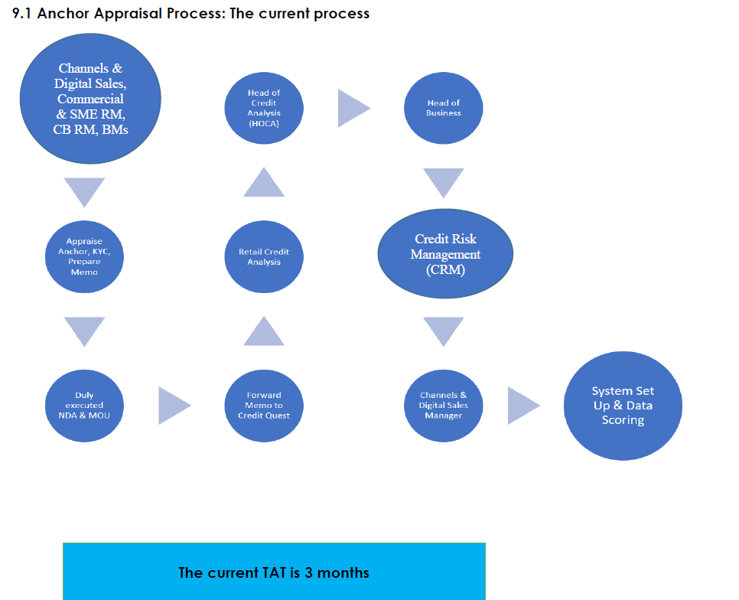
Previous Process

Slide 2
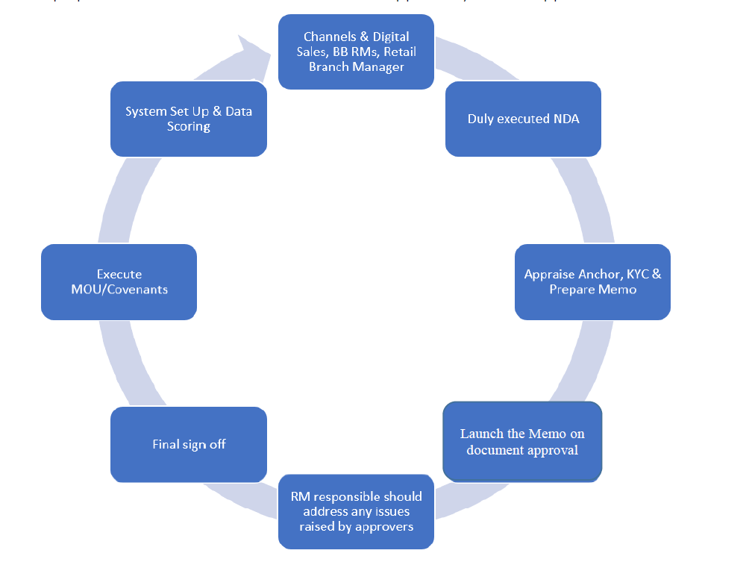
Current Process

Slide 3
Credit Appraisal to onboard anchor – RM
Includes Terms e.g. tenor, pricing, overall limit
Credit Application approved – CRM
Anchor onboarding
Sign standard MOU – Ecosystem Team & Legal
Sign Standard MOU & returns to Bank – Anchor
Fill in [maker-checker] approved program set up form and send to Credit Ops – Ecosystem team
Anchor Setup on LMS
Set up partner and loan product in BOOSTA LMS [maker-checker] – Credit Ops
Onboard Retailers [borrower] under the anchor on BOOSTA –Ecosystem CPA & RM
Digital Borrowing &Utilization of Lilmits
Monitor borrowing performance – RM, BM ,CPA & collections

